Slide 1

SDG Number- Goal 15
Department Of Electronics and Telecommunication Engineering
Project Presentation -4
Project Title- Tomato Leaf Disease Detection
Presented By:
1.Kajal Mahadev Patil
2. Nikita Rajendra Patil
3. Shubham Sakhare
Guided By:

Slide 2
Introduction
For a long time, the agriculture industry has used modern science to meet the food demands of 7 billion people. However, there are numerous threats that people working in the agriculture industry face that threaten the food security of the human society
With the dawn of machine learning models, the early identification of plant diseases has been made much easier, less time consuming and cheaper in comparison to the traditional visual identification of plant diseases
It will help farmers to detect and predict the disease, which will technically benefit in cure and improving production

Slide 3
Literature survey
 | Research paper | Authors | Name of journal | Year of Publication publication | Hyperlink
1. | IEEE | a) Abhishek Singh b) Mohit Agrawal | Tomato Leaf Dieases Detection Using convolutional neural network | 2019 | https://www.sciencedirect.com/science/article/pii/S1877050920306906
2. | IEEE | a) Ananda S. Paymode b) Vandana B. Malode | Tomato Leaf Disease Detection and Classification using Convolution Neural Network | 2021 | https://ieeexplore.ieee.org/document/9397001
3. | IEEE | Gemini Kishore B.Pavitra Velpula Rajesh | Tomato Leaf Disease Detection Using Deep Learning Techniques | 2020 | https://ieeexplore.ieee.org/document/9137986

Slide 4
Problem Statement
Current agriculture system fully maintained by humans.
Relies on visual observation.
The process is time consuming.
Confusion in recognition of similar diseases.

Slide 5
Aim & Objectives
Aim:
To study and understand Tomato leaf disease detection. And build the tomato leaf disease detection system.
Objectives:
To protect the Tomato Leaf from gating damage, decade.
To reduce the manpower of the frame.

Slide 6
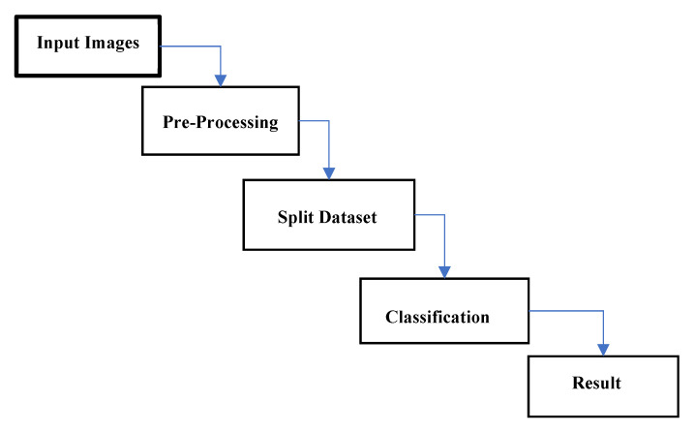
Methodology

Slide 7
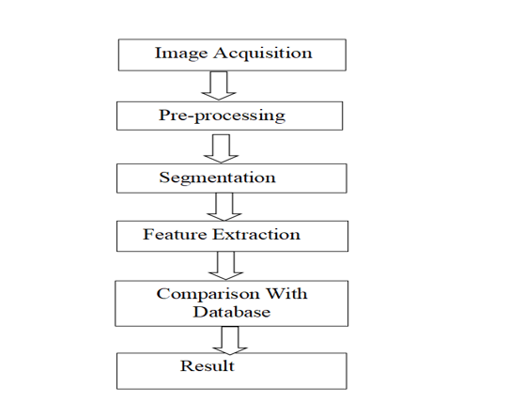
Block Diagram

Slide 8
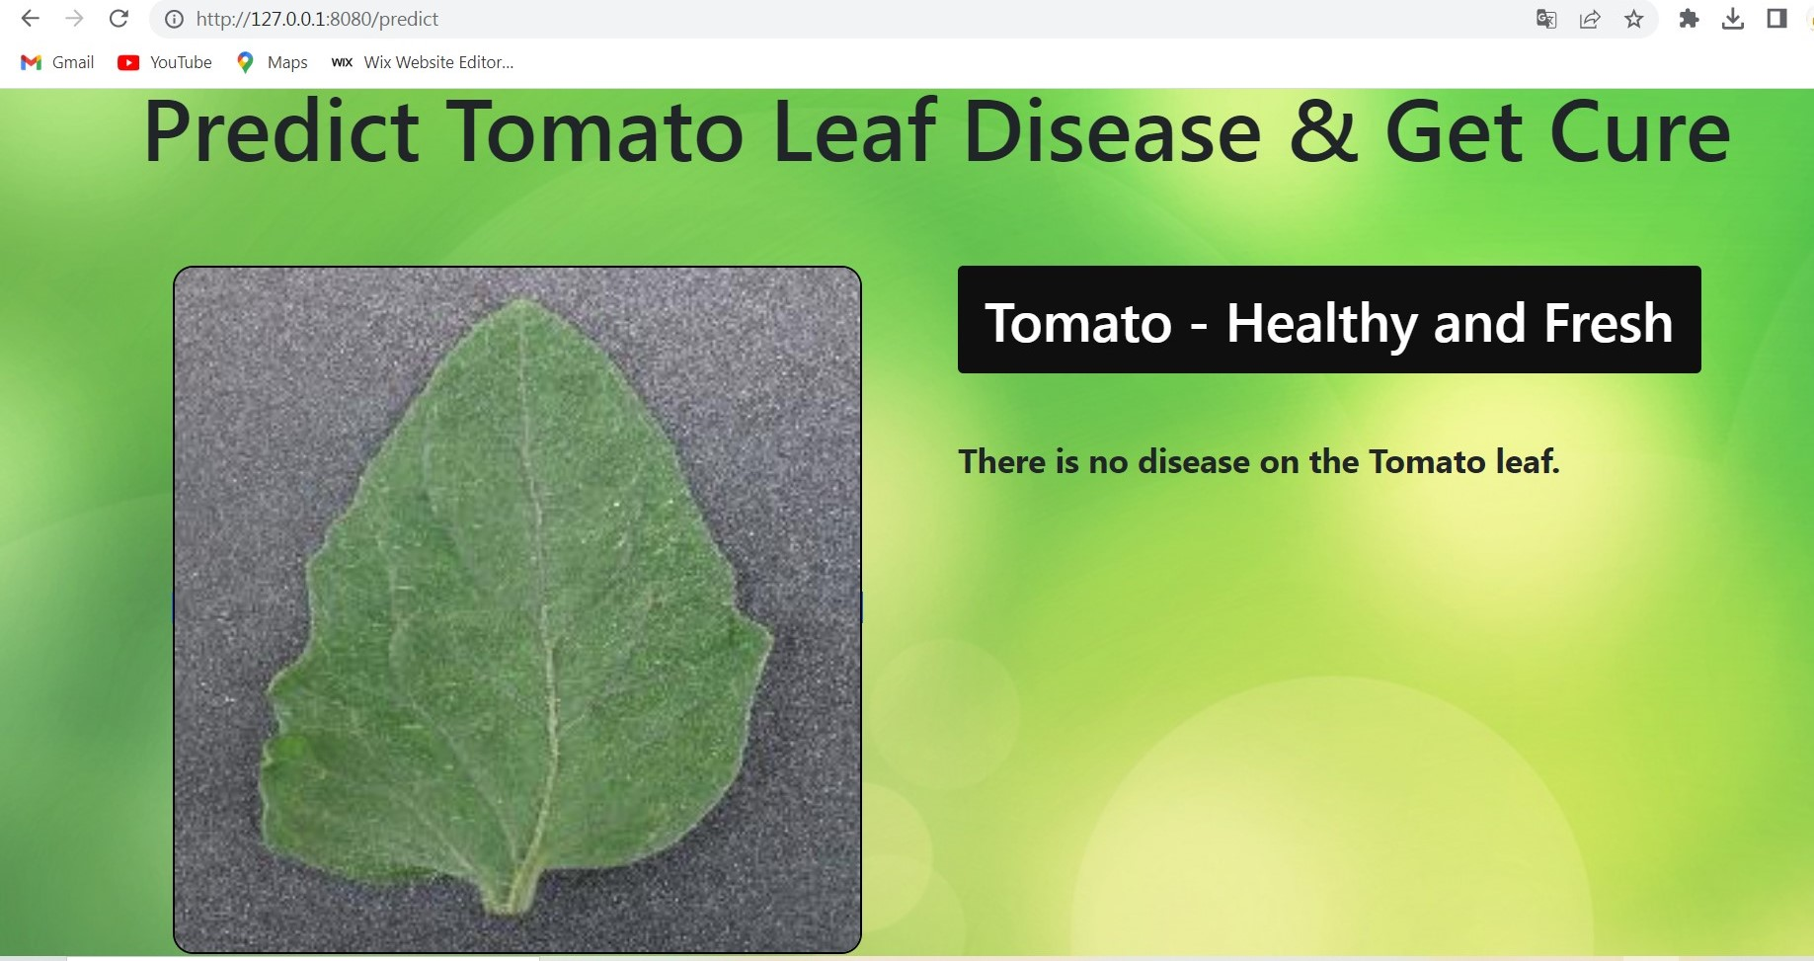
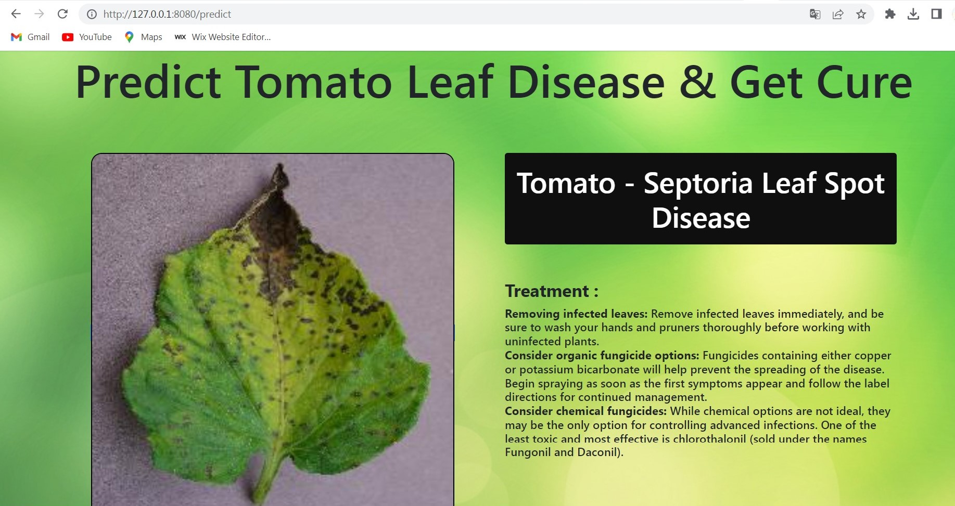
Working model(Live demo of working Model)
1) Healthy Leaf
2) Diseased Leaf

Slide 9
Conclusion
An image processing-based solution is proposed and evaluated in this project for the detection and classfication of Leaf diseases.
The proposed approach is composed of steps which include image preprocessing, image segmentation, performed features extracted and training and classification.It would also promote Indians farmers to do smart farming which helps to take a timely decisions which also saves time and reduce the loss of fruit due to the diseases to leading objective of our project is to enhance the value of Tomato leaf disease detection.

Slide 10
Future Scope
The dataset used in this study makes use of only tomato leaves from the plant village dataset. Due to the lack of enough Random Access Memory (RAM) storage the study had to be limited to only 10,000 images. In the future, it would be great to test the implementation of both the CNN and KNN model and also use LIME on the whole plant village dataset containing multiple different plants in order to bring detection and explainability to a wide variety of plants.

Slide 11
17 Sustainable Development Goals (SDGs)
GOAL 1: No Poverty
GOAL 2: Zero Hunger
GOAL 3: Good Health and Well-being
GOAL 4: Quality Education
GOAL 5: Gender Equality
GOAL 6: Clean Water and Sanitation
GOAL 7: Affordable and Clean Energy
GOAL 8: Decent Work and Economic Growth
GOAL 9: Industry, Innovation and Infrastructure
GOAL 10: Reduced Inequality
GOAL 11: Sustainable Cities and Communities
GOAL 12: Responsible Consumption and Production
GOAL 13: Climate Action
GOAL 14: Life Below Water
GOAL 15: Life on Land
GOAL 16: Peace and Justice Strong Institutions
GOAL 17: Partnerships to achieve the Goal

Slide 12
1 | Map the project title with PO's and PSO's on the scale of 3. 3-Substantial mapping 2-Moderate mapping 1-Low mapping
2 | Refer 12 PO's
 | 1 | Apply the knowledge of mathematics, science, engineering fundamentals, and engineering specialization to the solution of complex engineering problems. [Engineering knowledge]
 | 2 | Identify, formulate, research literature, and analyze complex engineering problems reaching substantiated conclusions using first principles of mathematics, natural sciences, and engineering sciences.[Problem analysis]
 | 3 | Design solutions for complex engineering problems and design system components or processes that meet the specified needs with appropriate consideration for the public health and safety, and the cultural, societal, and environmental considerations. [Design/development of solutions]
 | 4 | Use research-based knowledge and research methods including design of experiments, analysis and interpretation of data, and synthesis of the information to provide valid conclusions. [ Conduct investigations of complex problems]
 | 5 | Create, select, and apply appropriate techniques, resources, and modern engineering and IT tools including prediction and modeling to complex engineering activities with an understanding of the limitations. [ Modern tool usage]

Slide 13
7 | Understand the impact of the professional engineering solutions in societal and environmental contexts, and demonstrate the knowledge of, and need for sustainable development. [ Environment and sustainability]
8 | Apply ethical principles and commit to professional ethics and responsibilities and norms of the engineering practice. [ Ethics]
9 | Function effectively as an individual, and as a member or leader in diverse teams, and in multidisciplinary settings. [ Individual and team work]
10 | Communicate effectively on complex engineering activities with the engineering community and with society at large, such as, being able to comprehend and write effective reports and design documentation, make effective presentations, and give and receive clear instructions. [ Communication]
11 | Demonstrate knowledge and understanding of the engineering and management principles and apply these to one’s own work, as a member and leader in a team, to manage projects and in multidisciplinary environments. [ Project management and finance]
12 | Recognize the need for, and have the preparation and ability to engage in independent and life-long learning in the broadest context of technological change. [Life-long learning]
Refer 2 PSO's
1 | Apply domain specific knowledge to develop electronics and telecommunication systems/applications
2 | Select different software tools, test and measurement equipment and use them efficiently for system solutions.

Slide 14
Map the project title with PO's and PSO's on the scale of 3. 3-Substantial mapping 2-Moderate mapping 1-Low mapping
Gr. No | Project Title | Project Guide | PO1 | PO2 | PO3 | PO4 | PO5 | PO6 | PO7 | PO8 | PO9 | PO10 | PO11 | PO12 | PSO1 | PSO2
1 | Automatic traffic Controlling system using raspberry pi | Mrs. Geeta Salunkhe | 2 | 3 | 2 | 1 | 2 | 1 | 2 | 3 | 3 | 3 | 2 | 3 | 2 | 3

Slide 15
References
Agarwal, M. et al. (2020) ‘ToLeD: Tomato Leaf Disease Detection using Convo lution Neural Network’, Procedia Computer Science, 167, pp. 293–301. doi: 10.1016/j.procs.2020.03.225. Agrios, G. N. (2005) ‘chapter ten - ENVIRONMENTAL FACTORS THAT CAUSE PLANT DISEASES’, in Agrios, G. N. (ed.) Plant Pathology (Fifth Edi tion). San Diego: Academic Press, pp. 357–384. doi: 10.1016/B978-0-08- 047378-9.50016-6. Al-Sadi, A. (2017) ‘Impact of Plant Diseases on Human Health’, International Journal of Nutrition, Pharmacology, Neurological Diseases, 7, pp. 21–22. doi: 10.4103/ijnpnd.ijnpnd_24_17. Ault, R. (2020) ‘Optimization Study of an Image Classification Deep Neural Network’, Final Report, p. 10. Bishop, P. and Herron, R. (2015) ‘Use and Misuse of the Likert Item Responses and Other Ordinal Measures’, International Journal of Exercise Science, 8, p. Article 10. Chakrabartty, S. N. (2014) ‘Scoring and Analysis of Likert Scale: Few Ap proaches’, Jr. of Knowledge Management & Information Technology, 1. Dieber, J. and Kirrane, S. (2020) ‘Why model why? Assessing the strengths and limitations of LIME.’, CoRR.

